Slide 1
Building a 3d World Chapter 1 Spicing Things Up with Particles

Slide 2
In this chapter, we’ll start off our new project by exploring the world of particles—simple objects drawn as a set of points.
We can use a combination of basic physics and rendering to come up with some really neat effects.
We can simulate the effects of rain, or we can create explosions and fireworks

Slide 3
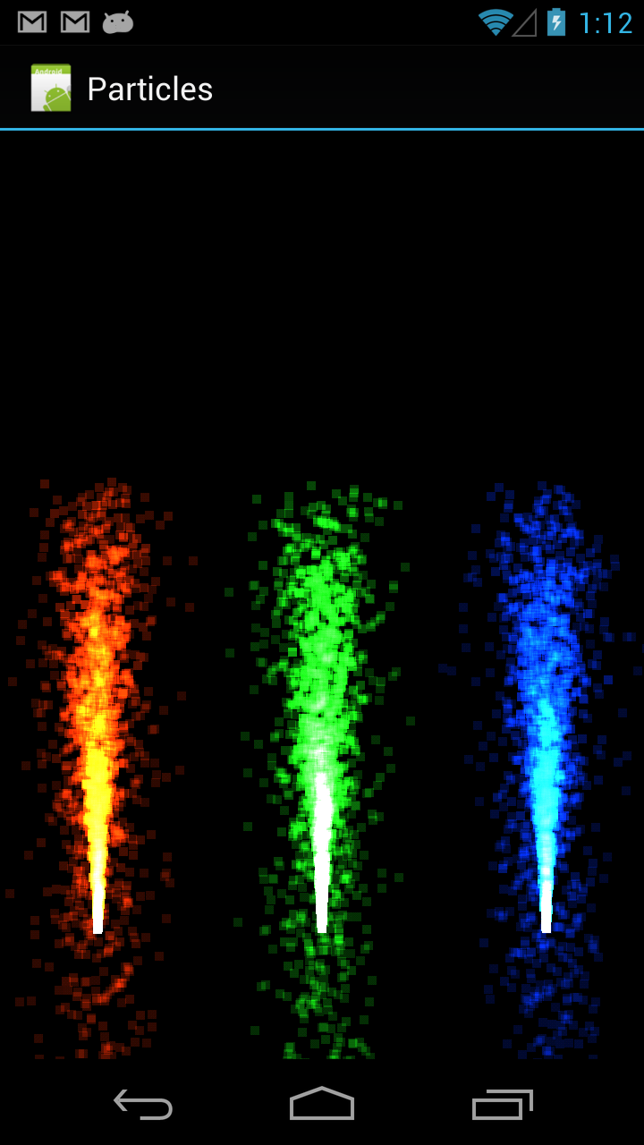
Final Target

Slide 4
Content
Creating a Set of Shaders for a Simple Particle System
Adding the Particle System
Drawing the Particle System
Spreading Out the Particles
Adding Gravity
Mixing the Particles with Additive Blending
Customizing the Appearance of Our Points
Drawing Each Point as a Sprite

Slide 5
Creating a Set of Shaders for a Simple Particle System
We could use an array of Java objects for this, but it can be expensive to create and delete a bunch of objects during runtime, and there’s no easy way to send the data over to OpenGL. We can store all of the particle data inline instead, inside a single array.
To add a particle, we’ll just need to increase the particle count, write the data to our particle array, and copy over the changed contents to our native buffer. When we run out of space, we can recycle the array by starting over at the beginning.
We can represent each particle as a single vertex and draw these vertices as a set of points, each with a unique position and color.
We can do some of this work on the GPU by putting the logic in a shader program.
In this method we are doing fragment shader and vertex shader i.e. glsl file and declaring in the java file and naming the file particleshaderprogram.java

Slide 6
Adding the Particle System
We have a floating-point array to store the particles, a Vertex Array to represent the data that we’ll send to OpenGL, and maxParticleCount to hold the maximum number of particles, since the size of the array is fixed
Android’s Color class returns components in a range from 0 to 255, while OpenGL expects the color to be from 0 to 1, so we convert from Android to OpenGL by dividing each component by 255.
In this method we doing the creating the objects for this particles (particleshooter.java and particlesystem.java)

Slide 7
Drawing the Particle System
In this method we are just rendering the particles into the particlerenderer.java
We have our standard variables for the Android context and our matrices, and we have our particle shader, system, and three particle shooters. We also have a variable for the global start time and a standard constructor.

Slide 8
Spreading out the particles
Each shooter will have an angle variance that will control the spread of particles and a speed variance to alter the speed of each particle. We also have a matrix and two vectors, so we can use Android’s Matrix class to do some math.
To alter the shooting angle, we use Android’s Matrix.setRotateEulerM() to create a rotation matrix that will alter the angle by a random amount of angleVariance, which is in degrees. We then multiply this matrix with the direction vector to get a slightly rotated vector. To adjust the speed, we multiply each component of the direction vector with an equal random adjustment of speedVariance.

Slide 9
Adding Gravity
Isaac Newton became famous because he observed the effects of gravity on apples falling from a tree; our particles will look better if we add some gravity to them as well.
This will calculate an accelerating gravity factor by applying the gravitational acceleration formula and squaring the elapsed time; we also divide things by 8 to dampen the effect. The number 8 is arbitrary: we could use any other number that also makes things look good on the screen

Slide 10
Mixing the Particles with Additive Blending
The one we’d see at a fireworks show, then we’d expect the particles to give off light; and the more of them there are, the brighter things should be. One of the ways that we can reproduce this effect is by using additive blending.
In OpenGL, blending works by blending the result of the fragment shader with the color that’s already there in the frame buffer. The value for source fragment comes from our fragment shader, destination fragment is what’s already there in the frame buffer, and the values for source factor and destination factor are configured by calling glBlendFunc()

Slide 11
Customizing the Appearance of Our Points
Using another special OpenGL variable, gl_PointCoord, we can actually customize the appearance of our points. For each point, when the fragment shader is run, we’ll get a two-dimensional gl_PointCoord coordinate with each component ranging from 0 to 1 on each axis, depending on which fragment in the point is currently being rendered.
The way this works is that for each fragment, we calculate the distance to the center of the point with Pythagoras’s theorem

Slide 12
Drawing Each Point as a Sprite
Using the same gl_PointCoord and a texture, we can actually draw each point as a point sprite
The texture color will be multiplied with the point color, so the points will be colored the same way as before.
Texture Images

Slide 13
Before adding the texture image
After adding the texture image

